Slide 1
STOR 455 Inference for Coefficients
Read: 2.1, 2.3, 2.4
Exercises: 2.15b, 17bcd, 19bc

Slide 2
Simple Linear Regression
modlego2 = lm(Amazon_Price^(0.3)~Pieces, data=lego_under_800_pieces)
summary(modlego2)
Call:
lm(formula = Amazon_Price^(0.3) ~ Pieces, data = lego_under_800_pieces)
Residuals:
Min 1Q Median 3Q Max
-1.10548 -0.35676 -0.07156 0.25655 2.99219
Coefficients:
Estimate Std. Error t value Pr(>|t|)
(Intercept) 2.311e+00 2.949e-02 78.36 <2e-16 ***
Pieces 2.230e-03 9.029e-05 24.70 <2e-16 ***
---
Signif. codes: 0 ‘***’ 0.001 ‘**’ 0.01 ‘*’ 0.05 ‘.’ 0.1 ‘ ’ 1
Residual standard error: 0.4807 on 716 degrees of freedom
(393 observations deleted due to missingness)
Multiple R-squared: 0.4601, Adjusted R-squared: 0.4593
F-statistic: 610.1 on 1 and 716 DF, p-value: < 2.2e-16

Slide 3
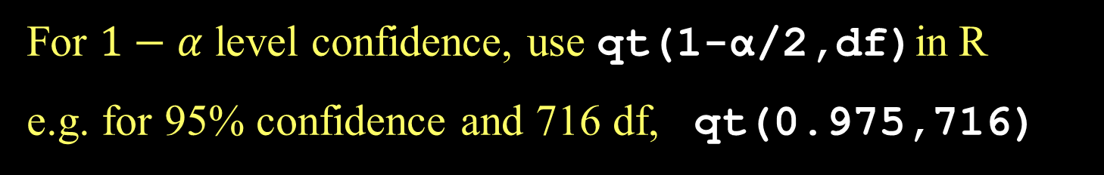
CI for Slope or Intercept
t* comes from a t-distribution with n-2 d.f and depends on the level of confidence
For $1−α$ level confidence, use qt(1-α/2,df)in R
e.g. for 95% confidence and 716 df, qt(0.975,716)

Slide 4
How to find a confidence interval?
confint(mymodel,level =0.XX) and adjust for the confidence level.
2.5 % 97.5 %
(Intercept) 2.253166766 2.368979914
Pieces 0.002052779 0.002407299

Slide 5
Accuracy of Predictions
Example:
For a Lego set with 127 pieces, what does our model predict will be the selling price on Amazon?
How accurate is that prediction?

Slide 6
Two Forms of Intervals for Regression
Confidence Interval for μ_{Y} (mean Y)
Where is the “true” line for that x? or
Where is the average Y for all with that x?
Prediction Interval for Individual Y
Where are most Y’s for that x?

Slide 7
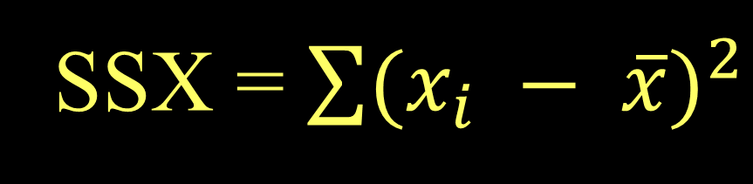
CI for μ_{Y} when X=x*
SSX = $\sum{{(x_{i} − \overline{x})}^{2}}$

Slide 8
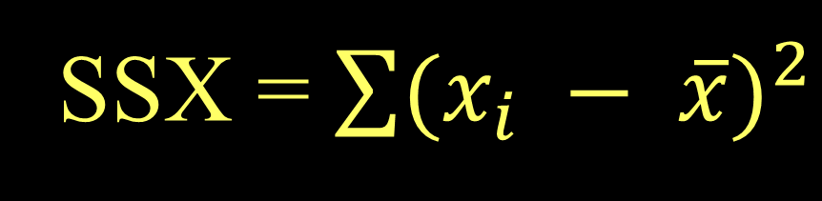
Prediction Interval for Individual Y’s when X=x*
accounts for ε in model
SSX = $\sum{{(x_{i} − \overline{x})}^{2}}$

Slide 9
CI and PI via R when X=x*
newx=data.frame(Pieces=127)
predict.lm(modlego2, newx, interval="confidence")
predict.lm(modlego2, newx, interval="prediction")
fit lwr upr
1 2.594288 2.551976 2.636601
fit lwr upr
1 2.594288 1.649688 3.538888

Slide 10
CI and PI via R when X=x*
predict.lm(modlego2, newx, interval="confidence")^(10/3)
predict.lm(modlego2, newx, interval="prediction")^(10/3)
fit lwr upr
1 23.99169 22.71199 25.32102
fit lwr upr
1 23.99169 5.304847 67.53925

Slide 11
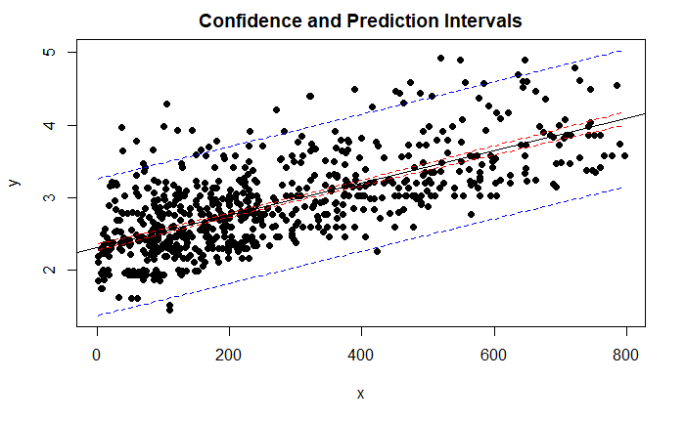
CIPIPlot(lego_under_800_pieces$Pieces, lego_under_800_pieces$Amazon_Price^(0.3))

Slide 12
T-test for Slope
H_{o}: β₁ = 0
H_{a}: β₁ ≠ 0
vs.
Find p-value using a
t-distribution and n-2 d.f.
p-value is small ↔ Reject H_{o}

Slide 13
How to find a P-value?
Statistically significant evidence suggests ( p-value < 2.2*10⁻¹⁶) that there is a linear relationship between the number of pieces in a Lego set and the selling price on Amazon.
Call:
lm(formula = Amazon_Price^(0.3) ~ Pieces, data = lego_under_800_pieces)
Coefficients:
Estimate Std. Error t value Pr(>|t|)
(Intercept) 2.311e+00 2.949e-02 78.36 <2e-16 ***
Pieces 2.230e-03 9.029e-05 24.70 <2e-16 ***
---
Signif. codes: 0 ‘***’ 0.001 ‘**’ 0.01 ‘*’ 0.05 ‘.’ 0.1 ‘ ’ 1
Residual standard error: 0.4807 on 716 degrees of freedom
(393 observations deleted due to missingness)
Multiple R-squared: 0.4601, Adjusted R-squared: 0.4593
F-statistic: 610.1 on 1 and 716 DF, p-value: < 2.2e-16

Slide 14
Finding Correlation in R
For data in two variables:
cor(dataframe$variable1, dataframe$variable2)
[1] 0.9581758
For all variables in a dataframe:
data(Houses)
cor(Houses)
Price Size Lot
Price 1.0000000 0.6848219 0.7157072
Size 0.6848219 1.0000000 0.7668722
Lot 0.7157072 0.7668722 1.0000000

Slide 15
Finding Correlation in R
Watch out – variables must be numeric!
data(Cereal)
cor(Cereal)
Error in cor(Cereal) : 'x' must be numeric
May need to choose numeric columns:
cor(Cereal[c(2,3,4)])
Calories Sugar Fiber
Calories 1.0000000 0.5154008 -0.7150123
Sugar 0.5154008 1.0000000 -0.5025772
Fiber -0.7150123 -0.5025772 1.0000000

Slide 16
Test for a Linear Relationship via Correlation
Let ρ (rho) denote the population correlation
H_{o}: ρ=0
H_{a}: ρ≠0
Compare to a t-distribution with n-2 d.f.

Slide 17
Correlation t-test in R
cor.test(lego_under_800_pieces$Pieces, lego_under_800_pieces$Amazon_Price^(0.3))
Pearson's product-moment correlation
data: lego_under_800_pieces$Pieces and lego_under_800_pieces$Amazon_Price^(0.3)
t = 24.699, df = 716, p-value < 2.2e-16
alternative hypothesis: true correlation is not equal to 0
95 percent confidence interval:
0.6367026 0.7159108
sample estimates:
cor
0.6782721
Coefficients:
Estimate Std. Error t value Pr(>|t|)
(Intercept) 2.311e+00 2.949e-02 78.36 <2e-16 ***
Pieces 2.230e-03 9.029e-05 24.70 <2e-16 ***
---
Signif. codes: 0 ‘***’ 0.001 ‘**’ 0.01 ‘*’ 0.05 ‘.’ 0.1 ‘ ’ 1
Residual standard error: 0.4807 on 716 degrees of freedom
(393 observations deleted due to missingness)
Multiple R-squared: 0.4601, Adjusted R-squared: 0.4593
F-statistic: 610.1 on 1 and 716 DF, p-value: < 2.2e-16

Slide 18
ANOVA for Regression
=
+
Data
Model
Error
=
+
TOTAL variation in response, Y
Variation explained by MODEL
Unexplained variation in RESIDUALS
Key question: Does the MODEL explain a “significant” amount of the TOTAL variability?

Slide 19
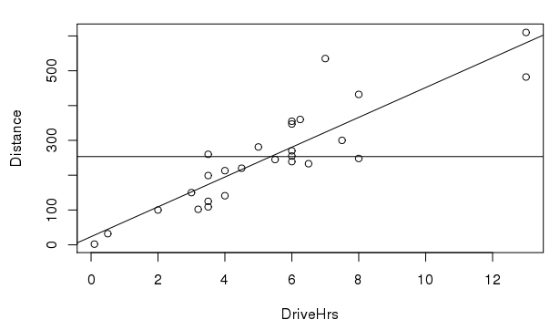

TOTAL variation in response, Y
$$\overline{y}$$
*Not our data. For visualization purposes

Slide 20

Variation explained by MODEL
$$\overline{y}$$
*Not our data. For visualization purposes

Slide 21
Unexplained variation in RESIDUALS
*Not our data. For visualization purposes

Slide 22
Partitioning Variability - SLM
Y
=
β_{o} + β₁X
+
ε
=
+
=
+
=
SSModel
+
SSE
SSTotal

Slide 23
Simple Linear Regression - R
modlego2 = lm(Amazon_Price^(0.3)~Pieces, data=lego_under_800_pieces)
summary(modlego2)
Call:
lm(formula = Amazon_Price^(0.3) ~ Pieces, data = lego_under_800_pieces)
Residuals:
Min 1Q Median 3Q Max
-1.10548 -0.35676 -0.07156 0.25655 2.99219
Coefficients:
Estimate Std. Error t value Pr(>|t|)
(Intercept) 2.311e+00 2.949e-02 78.36 <2e-16 ***
Pieces 2.230e-03 9.029e-05 24.70 <2e-16 ***
---
Signif. codes: 0 ‘***’ 0.001 ‘**’ 0.01 ‘*’ 0.05 ‘.’ 0.1 ‘ ’ 1
Residual standard error: 0.4807 on 716 degrees of freedom
(393 observations deleted due to missingness)
Multiple R-squared: 0.4601, Adjusted R-squared: 0.4593
F-statistic: 610.1 on 1 and 716 DF, p-value: < 2.2e-16

Slide 24
R – ANOVA for a Regression Model
anova(modlego2)
Analysis of Variance Table
Response: Amazon_Price^(0.3)
Df Sum Sq Mean Sq F value Pr(>F)
Pieces 1 140.94 140.938 610.06 < 2.2e-16 ***
Residuals 716 165.41 0.231
---
Signif. codes: 0 ‘***’ 0.001 ‘**’ 0.01 ‘*’ 0.05 ‘.’ 0.1 ‘ ’ 1

Slide 25

ANOVA Test for Regression
Basic idea: Find two estimators of σ_{ε}²
Model ⇒
Compare
Error ⇒
Compare to F-distribution with 1 and $n−2$ d.f.

Slide 26
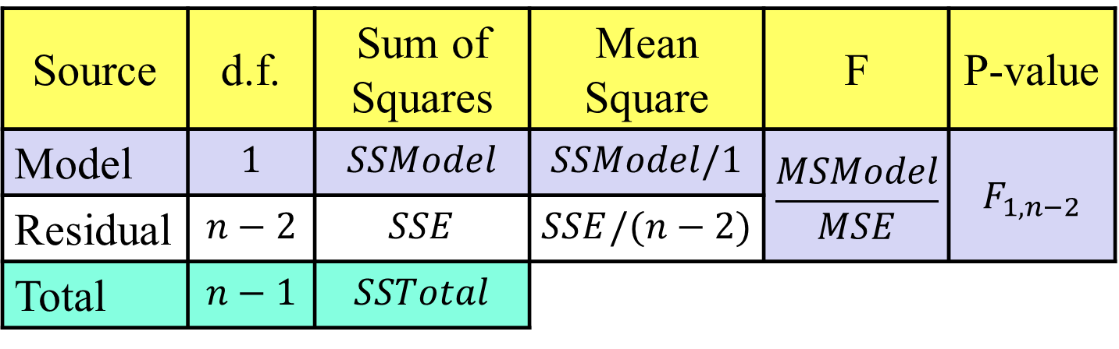


ANOVA Test for Regression
H_{o}: β₁ = 0
H_{a}: β₁ ≠ 0
vs.
($\overline{y}$)
($\hat{y}$)
Source | d.f. | Sum of Squares | Mean Square | F | P-value
Model | $$1$$ | $$SSModel$$ | $$SSModel/1$$ | $$\frac{MSModel}{MSE}$$ | $$F_{1,n−2}$$
Residual | $$n−2$$ | $$SSE$$ | $$SSE/(n−2)$$
Total | $$n−1$$ | $$SSTotal$$
in R use 1-pf(Fstat,1,n-2)

Slide 27
R – ANOVA for a Regression Model
anova(modlego2)
Analysis of Variance Table
Response: Amazon_Price^(0.3)
Df Sum Sq Mean Sq F value Pr(>F)
Pieces 1 140.94 140.938 610.06 < 2.2e-16 ***
Residuals 716 165.41 0.231
> summary(modlego2)
Some output omitted…
Coefficients:
Estimate Std. Error t value Pr(>|t|)
(Intercept) 2.311e+00 2.949e-02 78.36 <2e-16 ***
Pieces 2.230e-03 9.029e-05 24.70 <2e-16 ***
---

